Slide 1
Hyperparameter optimization using Optuna

Slide 2
Hyperparameter tuning
ML algorithms have model parameters and objective functions – which are optimized during the learning process
Hyperparameter tuning is the process of intelligently searching the search space of the parameters that are specified for the learning – i.e. user input/configuration

Slide 3
Hyperparameter tuning using Optuna
ML algorithm agnostic
Study – set up range of the parameters, which sampling (optimization algorithm) algorithm to use, and whether to maximize or minimize objectives
Trial – a single run of the ML algorithm + the parameters chosen from the study configuration

Slide 4
Today’s demo
Xgboost as the ML algorithm for classification
UCI adult dataset

Slide 5
UCI adult dataset

Slide 6
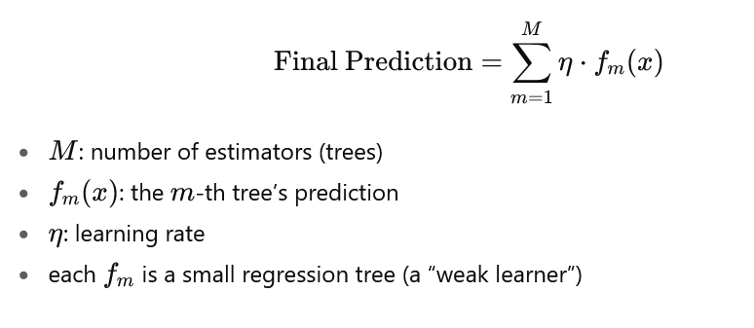
xgboost

Slide 7
xgboost
Learning rate: step size of model weight update
Number of estimators: number of trees
Max depth: depth of each tree
Guidelines
Small learning rate with larger number of estimators
More depth results in potential overfitting the training data

Slide 8
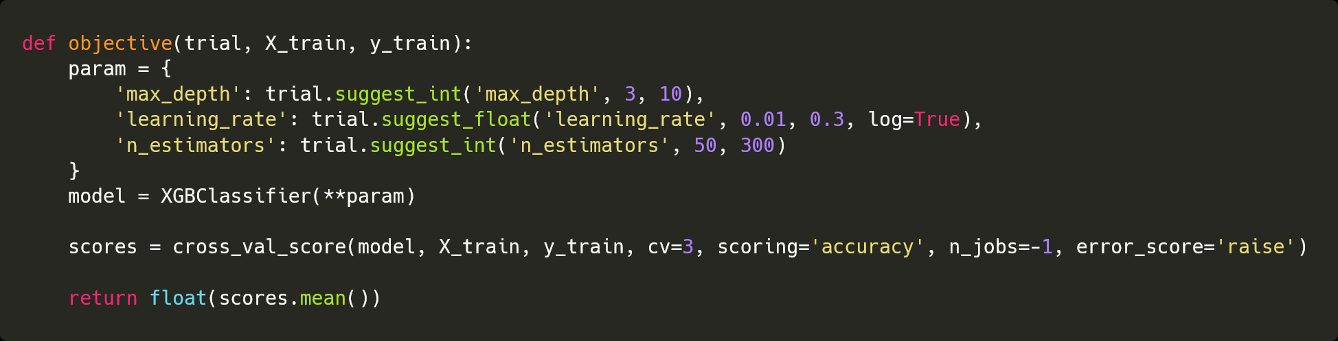
Objective function – single objective

Slide 9
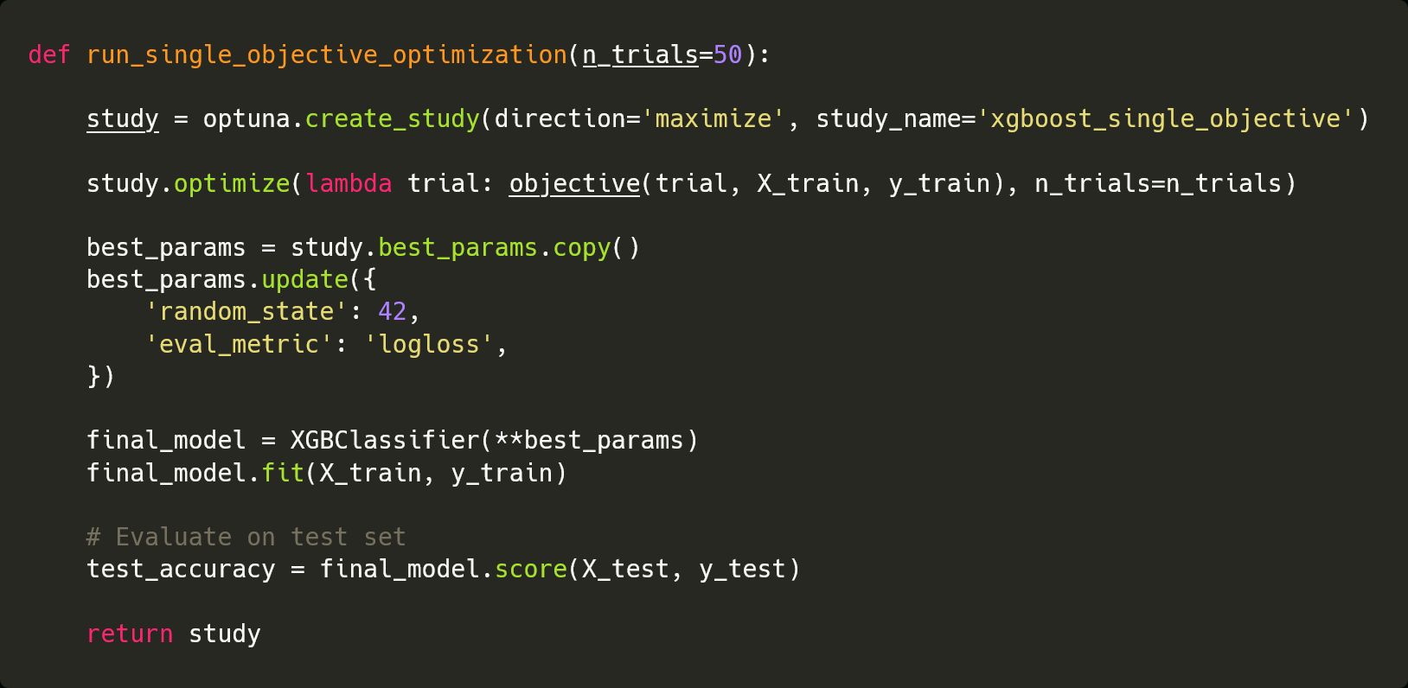
Study definition – single objective

Slide 10
DEMO

Slide 11
Objective function – multi objective

Slide 12
Study definition – multi objective

Slide 13
DEMO

